Slide 1

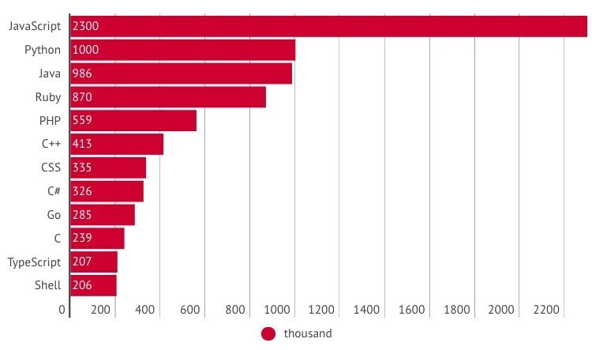
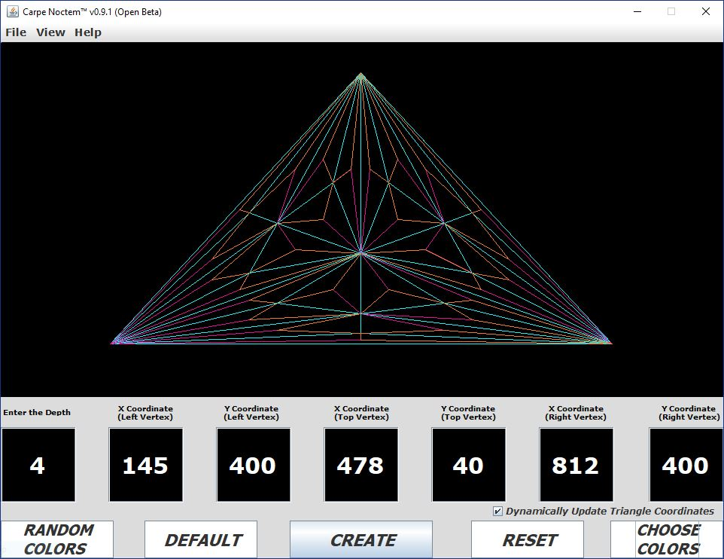
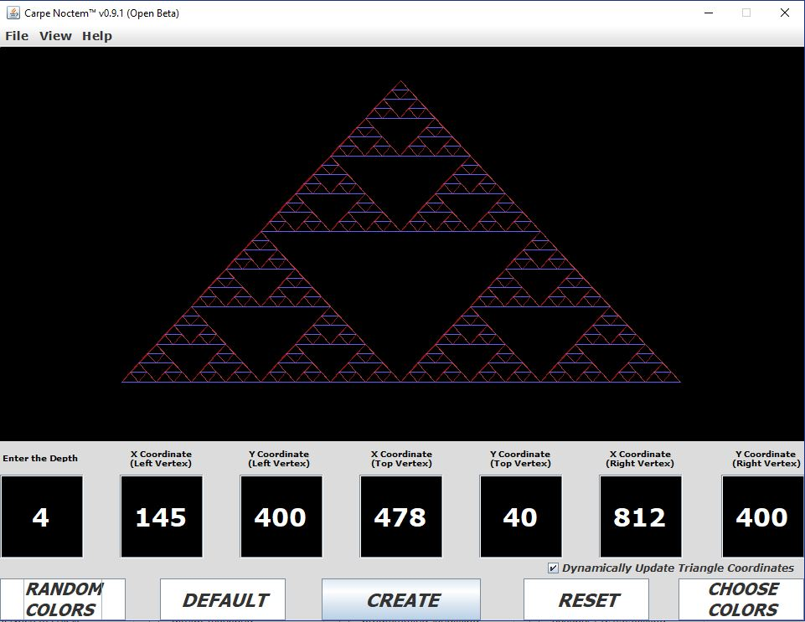

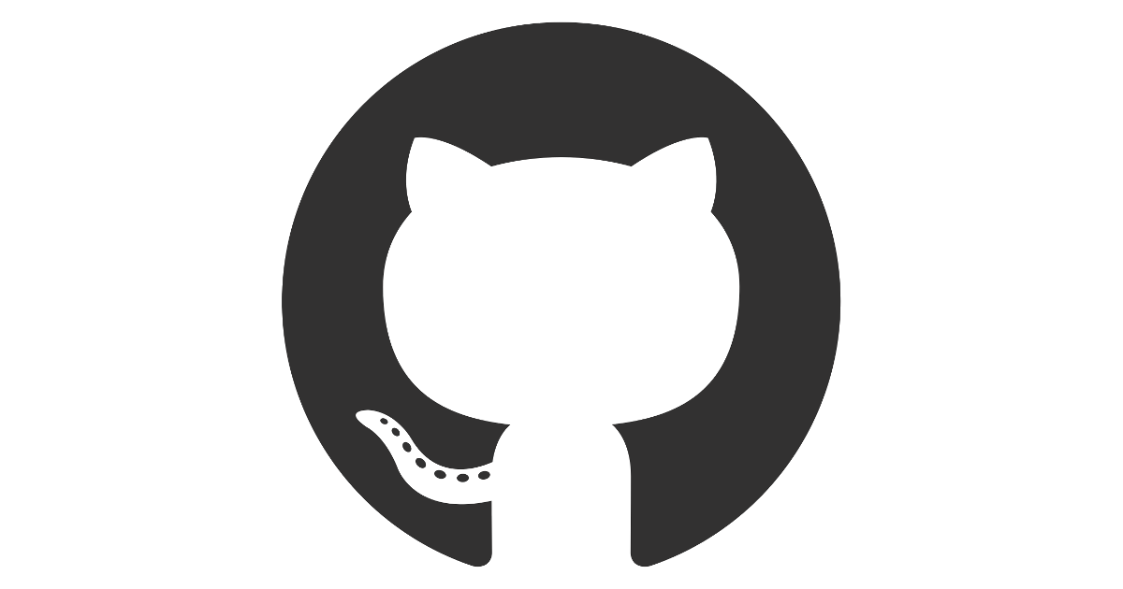
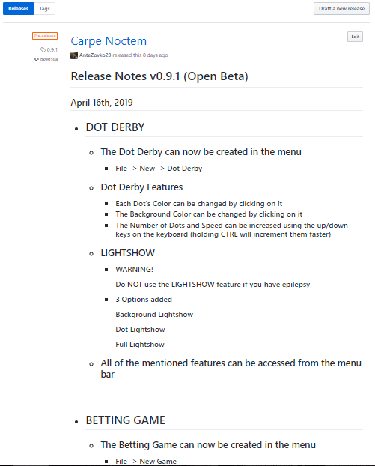
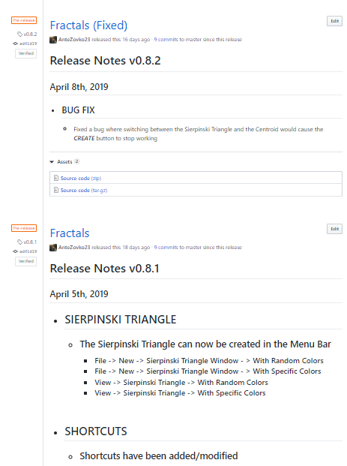
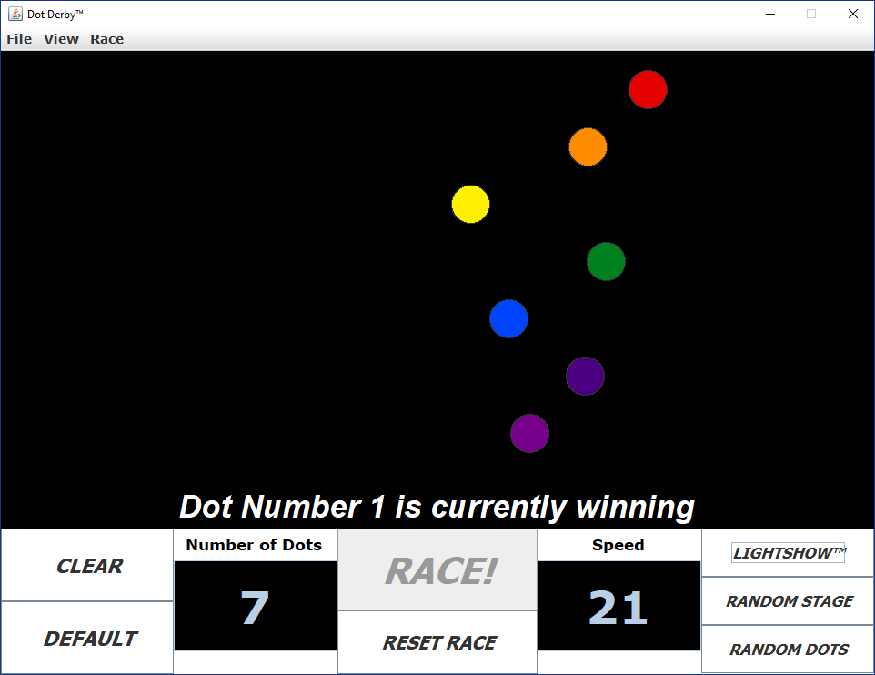
Using GitHub as an ePortfolio in Software Engineering
Motivation
How to demonstrate to employers the ability to write code and create software?
Interviews are not an effective way of demonstrating coding skills.
Employers look to hire a person for their ability to create software, not talk about the theory behind it.
Carpe Noctem is a way for me to show that I know how to create usable software products
Where?
Where to put software for other people to see?
There are many platforms for distributing software, but GitHub is the most popular option.
GitHub has many features that make developing and sharing code fast and easy
Carpe Noctem
Carpe Noctem (Latin for “Seize The Night”) is a desktop application I have developed, using the programming language “Java”, to show my programming skills.
I named it Carpe Noctem because I was working on it only during the night.
It features three labs from my first semester mixed with what I learned in my Graphical User Interface Design class this
semester.
More about GitHub
As of March 2017, GitHub has over 26 million users working across 67 million repositories, making it the world’s biggest host of source code.
Most projects are open source and written in one of 337 programming languages.
Over half a million students and 5,300 teachers are using GitHub. University of California, Berkeley has the most GitHub accounts (about 8,500) followed by Stanford University (4,000).
14.52% of Fortune 50 companies (largest companies by revenue in US) and 45% of Fortune 100 use GitHub Enterprise to develop software.
Source: https://www.rankred.com/facts-and-statistics-about-github/
Versions
v0.7.1 was released on April 1st, 2019
It featured the Centroid, Menu Bar and Buttons/TextFields for input
v0.8.1 (Alpha) was released on April 7th, 2019
It featured the Sierpinski Triangle and new Shortcuts
v0.9.1 (Open Beta) was released on April 16th, 2019
It featured the Dot Race, Dot Betting and Dynamic Coordinate Updates
Unexpected Outcomes
The project was supposed to be posted only as a downloadable folder on GitHub, but then the company emailed me and told me that I should use their “Release” feature to post release notes, versions and it would also allow me to reach more people.
On April 1st, I posted that v0.7.1 featuring the Sierpinski Triangle (second picture from the left) would be released on April 4th but I had some lab work to finish and didn’t have time to work on the triangle. Surprisingly, I got some emails from people asking me what happened to the new version and if I forgot to release it
Release Notes
Release Notes are important because they explain new features to the user and how they work

